Slide 1
SONG DATA ANALYSIS
Using Power BI

Slide 2
ABOUT THE DATASET
The dataset contains key attributes such as video ID, channel title, title, description, tags, published date, view count, like count, favorite count, comment count, video duration, video definition, and caption details.
Each row is identified by a unique video_id. Aim is to utilize Power BI to create insightful visualizations of YouTube songs' performance, popularity, and user engagement.

Slide 3
REPORT SUMMARY
In this report, I have created calculated columns, summary tables, and measures to extract meaningful information from the data. The key components are as follows:
Calculated Columns
Z Score Calculations: Calculated for likeCount, viewCount, and commentCount to identify outliers.
Days Since Published: Derived from the Published Date column to determine how long a video has been published.
Published Month and Published Time: Extracted from the Published Date column to analyze patterns based on publication time.
Daily Views: Calculated as views divided by days since published, providing insights into the daily view rate.

Slide 4
REPORT SUMMARY (CONT..)
Tags Table
Tag Extraction: Created a separate table where all tags were split by their delimiter and extracted into individual rows.
Summary Table: Aggregated total likes, views, and comments for each tag, providing a comprehensive overview of tag performance.
Measures
Covariance and Correlation: Created measures to calculate the covariance and correlation between various metrics.
Popular Video Since Publish: Identified the most popular video based on views per day.
View-Like Percentage: Calculated the percentage of likes relative to views for each video.

Slide 5
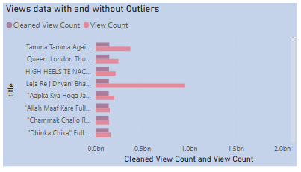
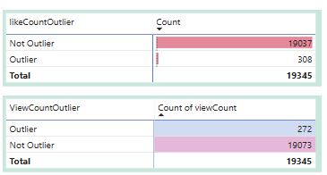
Outliers and Missing Values
Handling Missing Values
Description and Tags Columns: The dataset contains missing values in the Description and Tags columns.
Detecting and Handling Outliers
Like Count, View Count, and Comment Count Columns: Outliers in the Like Count, View Count, and Comment Count columns were identified and treated using the following steps:
Z-Score Method: The Z-score was used to detect outliers. Data points with a Z-score greater than 3 or less than -3 were considered outliers.
Capping and Flooring:
Capping: Values above the 98th percentile were capped at the 98th percentile.
Flooring: Values below the 5th percentile were floored at the 5th percentile.

Slide 6
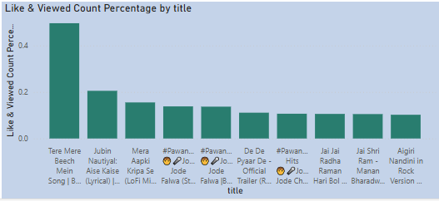
Popularity Trends
This graph displays the View-Like Percentage, highlighting that the song "Tre Vaaste" has the highest view-like percentage. This percentage represents the ratio of likes to views for each video. For example, if a video has 10 likes and 100 views, its view-like percentage is 10%.

Slide 7
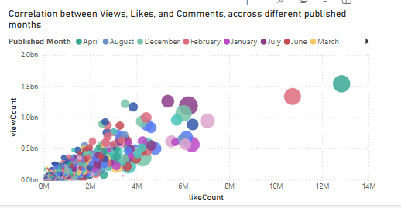
As the number of Views increases the number of likes and comments also increase.

Slide 8
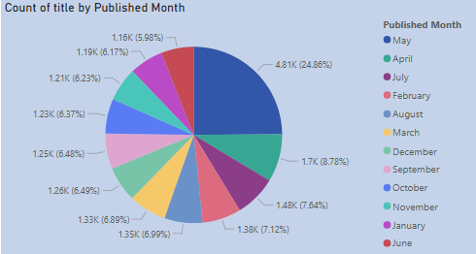
This graph displays the number of songs published monthwise. May has the highest number of publishings, followed by April and July.
i.e Mid year has the highest songs published.

Slide 9
tags | Total Views in 100K | Total Likes in 100K | Total Comments in 100K
'tseries' | 1,122,711.74 | 8,759.67 | 273.29
'bollywood songs' | 1,074,694.22 | 7,977.36 | 233.50
'hindi songs' | 1,035,478.58 | 6,898.37 | 207.85
'Songs' | 929,731.88 | 6,101.00 | 175.75
Most Popular Tags and its View , Like and Comments Counts
Most Commonly used tag as per the given dataset are T-series, hindi songs, bollywood songs etc.

Slide 10
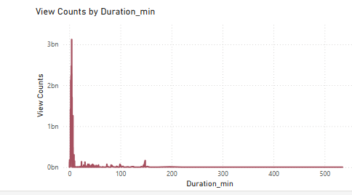
Views based on duration
Videos having less duration are more popular when compared to the ones with longer duration.
Here the duration is diplayed in terms of minutes.

Slide 11
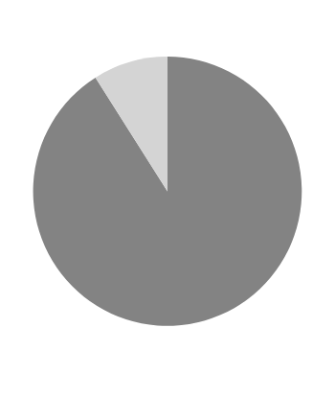

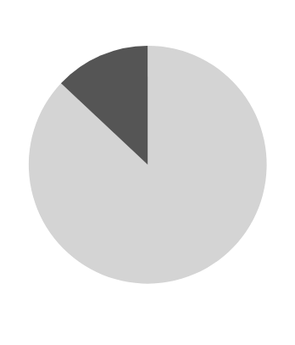
Correlation Count Between Views , Likes, Comment
Correlation betwwen Views and Likes
Correlation betwwen Views and Comments
Correlation betwwen Likes and Comments

Slide 12
THANK YOU!

